Slide 1
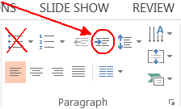
How to use this presentation template
DELETE THIS PAGE BEFORE PRINTING OR PRESENTING!
Here are some important tips for properly creating a PowerPoint presentation:
1) DO start with the eight sample slides that are already here (look/click in the Slide Sorter window at left). Their placeholder Titles are the same as their eight respective Layouts.
2) To add a new slide, either duplicate a slide that’s already in the Slide Sorter by right-clicking on the thumbnail and choosing Duplicate Slide, or create a new slide by going to HOME > Slides > New Slide, and choose a Layout from the dropdown.
3) DON’T CREATE NEW LAYOUTS. This is a template. Please use the existing Layouts.
4) DON’T USE AD HOC FORMATTING. Again, this is a template. Keep the headline, subhead and body formats as they are (don’t center them, don’t change the font, don’t add shadow, etc.).
5) To indent/add bullets, always DO USE THE DECREASE LEVEL button! This will automatically format your bullets and lists. There are only three levels of text: 1) No bullet/blue, 2) bullet/gray, and 3) bullet/gray DON’T USE THE BULLETS button! or your text/lists/bullets won’t be formatted to match the template.
Why is this important? If we update the template with new fonts etc., or if you ever have to copy a presentation into a new template, it will format correctly, automatically!

Slide 2
Section Divider Slide

Slide 3
Microsoft Azure Governance Hackshop
Notes:
Add name of primary proctor and their tile to this slide

Slide 4
What is Governance?
Establishment of policies, and continuous monitoring of their proper implementation, by the members of the governing body of an organization[…]¹
¹Source: BusinessDictionary

Slide 5
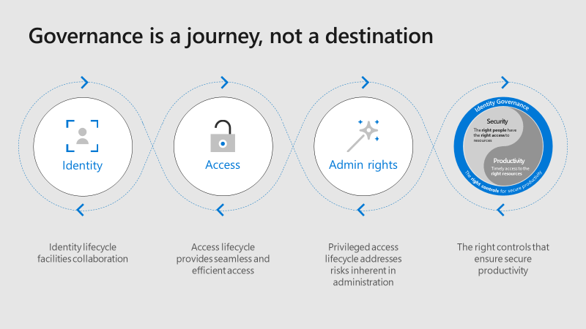
Source: Microsoft Ignite 2018 BRK3242

Slide 6
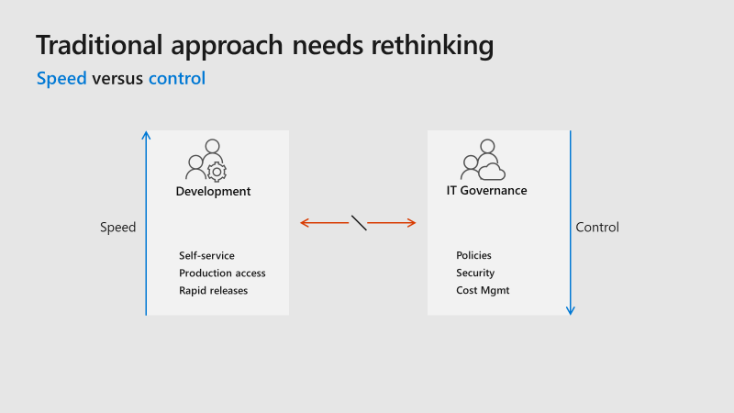
Source: Microsoft Ignite 2018 BRK2021

Slide 7
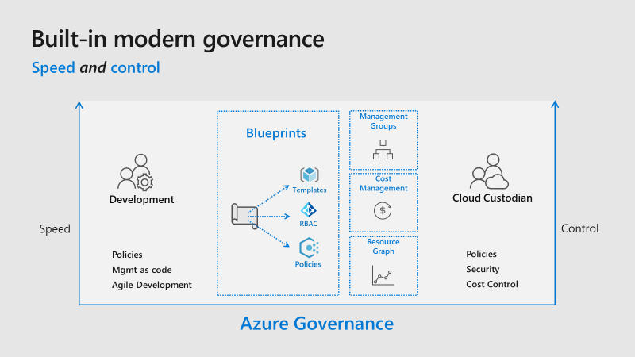
Source: Microsoft Ignite 2018 BRK2021

Slide 8
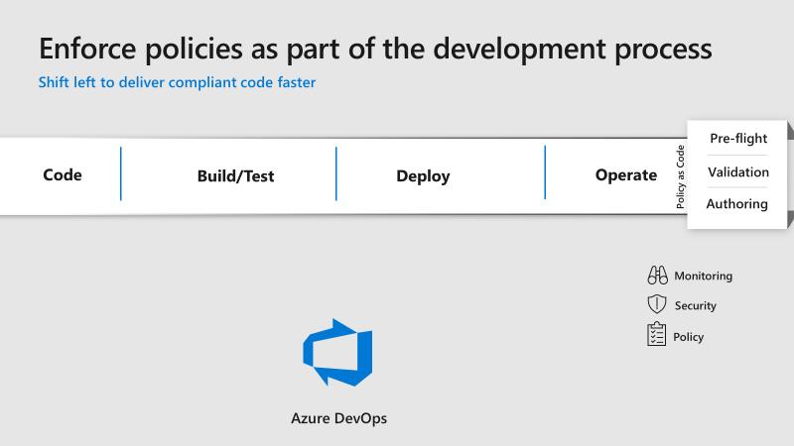
Source: Microsoft Ignite 2018 BRK2021

Slide 9
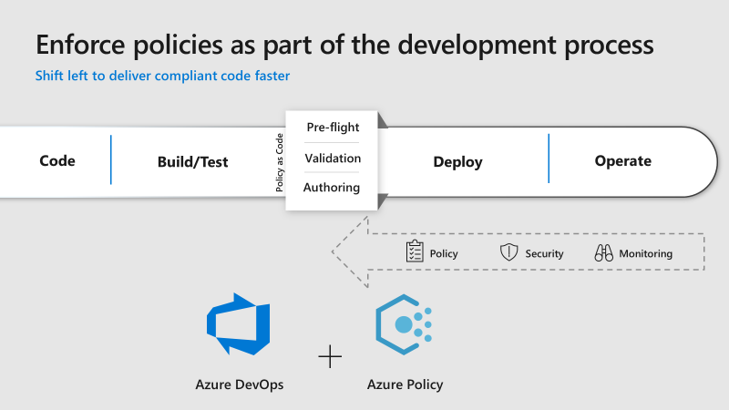
Source: Microsoft Ignite 2018 BRK2021

Slide 10
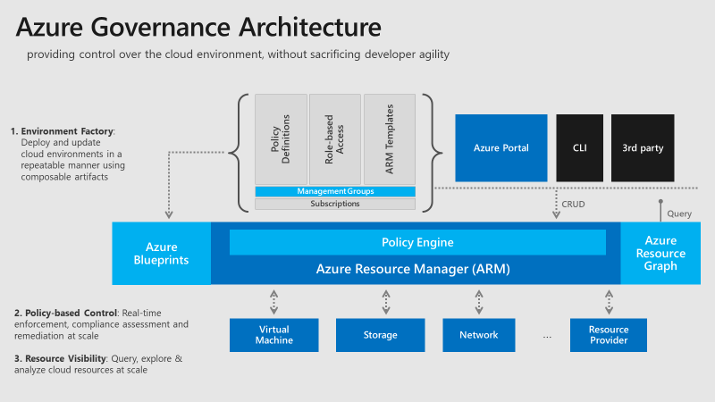
Source: Microsoft Ignite 2018 BRK3062

Slide 11
Organization Hierarchy
Notes:
The basis of the Enterprise Scaffolding strategy is determining the organization hierarchy

Slide 12
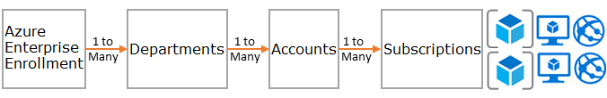
Organization Hierarchy
The foundation of Azure is the hierarchy and relationship of the Azure Enterprise Enrollment through to subscriptions and resource groups. The enterprise enrollment defines the shape and use of Azure services within your company from a contractual point of view. Within the enterprise agreement, you can further subdivide the environment into departments, accounts, and finally, subscriptions and resource groups to match your organization's structure.

Slide 13
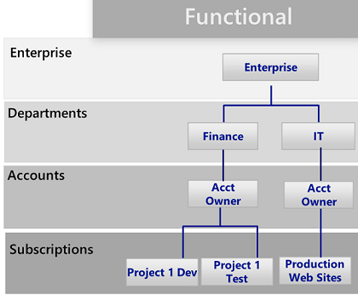
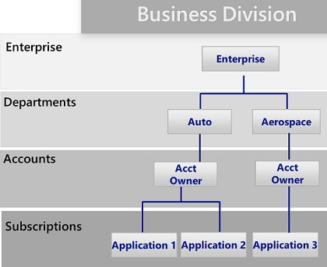
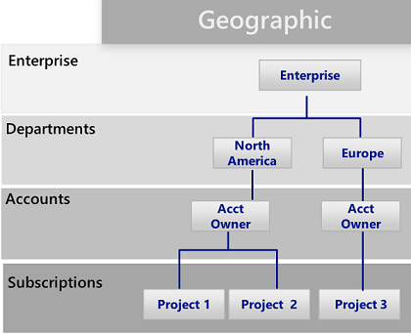
Organization Hierarchy – What Does This Potentially Look Like?
Notes:
There are 3 common patterns: Functional, Business Unit & Geographic. Emphasize there is no “one size fits all” and it is highly dependent on each organization. Does the on-premises hierarchy makes sense for Azure and a Cloud world?

Slide 14
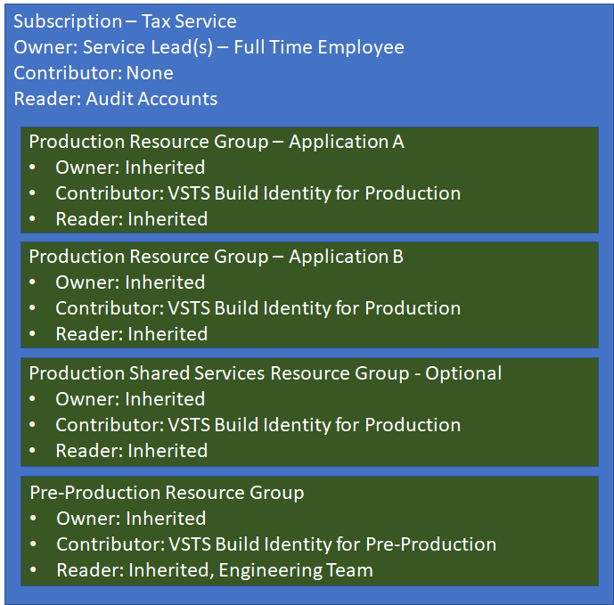
Organization Hierarchy – What Does This Potentially Look Like?
Notes:
Within the Resource Groups above the typical components in each resource group would be the Azure components used to build the specific services for that application
Reference the Shared Services Resource Group (Log Analytics, vNets, Blob Storage, etc)

Slide 15
Organization Hierarchy Challenge
Plan First, Act Second!
Challenge:
What would we like our organization’s Azure Hierarchy to be?
Should it “match” our on-premises hierarchy?
Empower people; trust instead of control
Whiteboard / Draw / Visio out possible hierarchies until your team has one they agree on
Your organization hierarchy could be the basis for future challenges, with a wide reaching impact!
Notes:
Try to avoid looking up existing patterns and practices guidelines for how people do this. Think! What makes sense for your organization?
You will want to follow the Enterprise -> Department -> Account -> Subscription hierarchy, however what makes up each one of those things (and how many) is entirely up to you

Slide 16
Organization Hierarchy Results
What did each team come up with?
What did you learn?

Slide 17
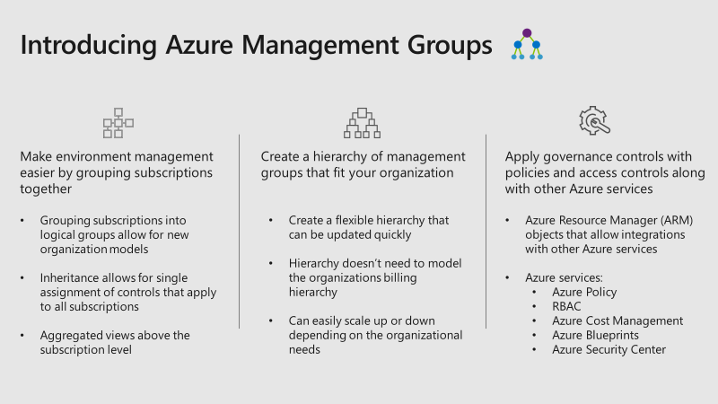
Management Groups

Slide 18
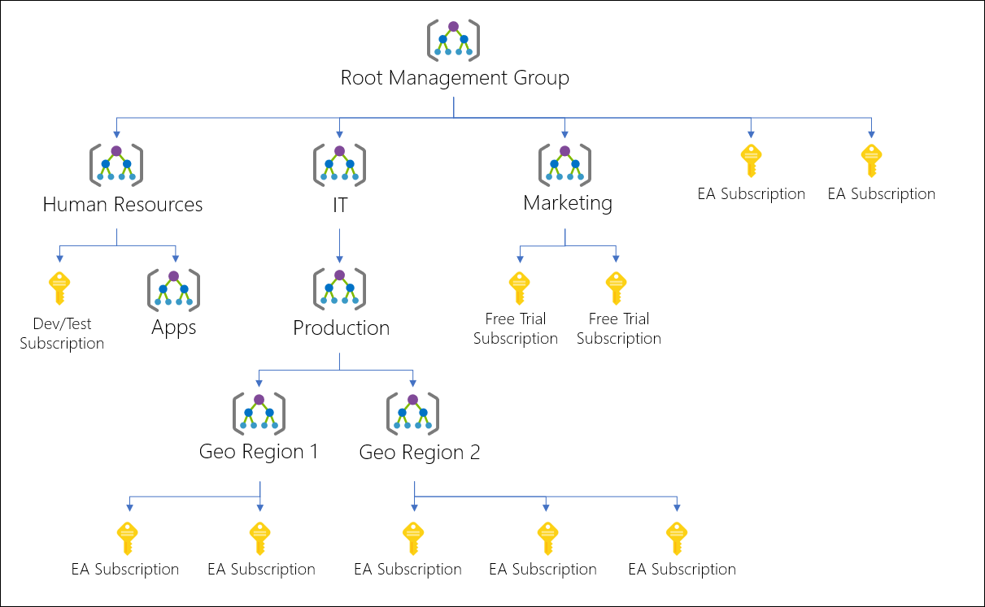
Management Groups: Example

Slide 19
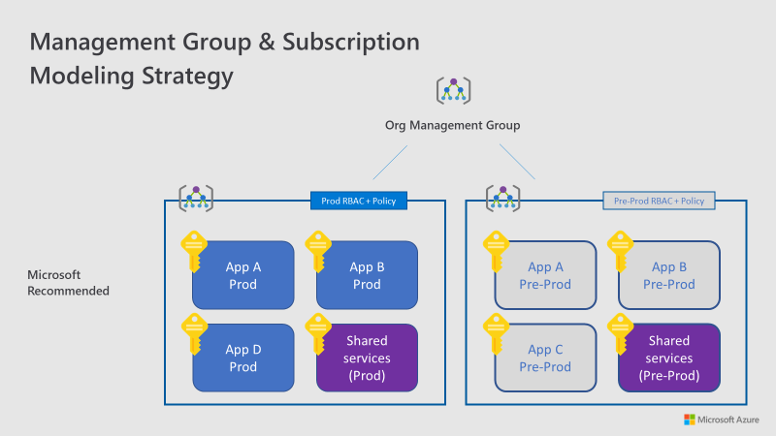
Management Groups: Example

Slide 20
Management Groups: Things to Think About
Create hierarchies so that you can apply policies later on in a way that makes sense.
Management groups allow you to create a hierarchy that is separate from your billing hierarchy, solely for efficient management of resources.
Management groups can mirror your billing hierarchy and often enterprises start that way.
The power of management groups is when you use them to model your organization where related subscriptions — regardless where they are in the billing hierarchy — are grouped together and need common roles assigned as well as policies and initiatives.
Think about creating management groups to provide users access to multiple subscriptions through one group.

Slide 21
Management Groups: Things to Think About
Policies applied at the Root Management group apply to all subscriptions and management groups below them (and so forth).
Each Management Group tree can support 6 levels of depth.
Each Management Group and subscription can have only one parent.
Each Management Group can have many children.

Slide 22
Subscriptions
When deciding on your Departments and Accounts (or management groups), you are primarily looking at how you're dividing up your Azure environment to match your organization.
Subscriptions are where the real work happens and your decisions here affect security, scalability and billing.

Slide 23
Subscriptions
Application/Service: Subscriptions represent an application or a service (portfolio of applications).
Lifecycle: Subscriptions represent a lifecycle of a service, such as Production or Development.
Department: Subscriptions represent departments in the organization.
Notes:
The first two patterns are the most commonly used, and both are highly recommended. The Lifecycle approach is appropriate for most organizations.

Slide 24
Management Groups & Subscriptions Challenge
Challenge:
What would we like our organization’s Management Group Hierarchy to be?
Should it “match” our billing hierarchy?
Empower people; trust instead of control
Include the subscription hierarchy in this design
Whiteboard / Draw / Visio out possible hierarchies until your team has one they agree on
Each team will use their Management Group & Subscription Hierarchy going forward in future challenges!

Slide 25
Management Groups & Subscriptions Results
What did each team come up with?
What did you learn?

Slide 26
Resource Groups
Azure Resource Manager (ARM) enables you to put resources into meaningful groups for management, billing, or natural affinity. Resource groups are containers of resources that have a common life cycle or share an attribute such as "all SQL servers" or "Application A”.
Like subscriptions, there are common patterns when creating resource groups and will vary from "Traditional IT" workloads to "Agile IT" workloads.

Slide 27
Resource Groups
Azure Resource Manager (ARM) enables you to put resources into meaningful groups for management, billing, or natural affinity. Resource groups are containers of resources that have a common life cycle or share an attribute such as "all SQL servers" or "Application A”.
Like subscriptions, there are common patterns when creating resource groups and will vary from "Traditional IT" workloads to "Agile IT" workloads.
Notes:
"Traditional IT" workloads are most commonly grouped by items within the same life cycle, such as an application. Grouping by application allows for individual application management.
"Agile IT" workloads tend to focus on external customer-facing cloud applications. The resource groups often reflect the layers of deployment (such as a web tier or app tier) and management.

Slide 28
Resource Groups: Things To Know
All the resources in your group should share the same lifecycle. You deploy, update, and delete them together. If one resource, such as a database server, needs to exist on a different deployment cycle it should be in another resource group.
Each resource can only exist in one resource group.
You can add or remove a resource to a resource group at any time.
You can move a resource from one resource group to another group.
A resource group can contain resources that are located in different regions.
A resource group can be used to scope access control for administrative action (RBAC).
A resource can interact with resources in other resource groups. This interaction is common when the two resources are related but don't share the same lifecycle (for example, web apps connecting to a database).
Notes:
"Traditional IT" workloads are most commonly grouped by items within the same life cycle, such as an application. Grouping by application allows for individual application management.
"Agile IT" workloads tend to focus on external customer-facing cloud applications. The resource groups often reflect the layers of deployment (such as a web tier or app tier) and management.

Slide 29
Resource Groups Challenge
Challenge:
What would we like our organizations Resource Group structure to be?
Whiteboard / Draw / Visio out possible structures until your team has one they agree on
Remember that your management group and subscription structure will affect the policies and access controls placed on the resource groups
How does this impact production and non-production environments?
How does this impact cloud born applications?
How does this impact a hybrid environment?
Notes:
If the groups feel that they need to go back and revisit any of the challenges previously done, encourage them to do so!

Slide 30
Resource Groups Results
What did each team come up with?
What did you learn?

Slide 31
Naming Conventions and Standards

Slide 32
Naming Conventions and Standards Challenge

Slide 33
Naming Conventions & Standards Results
What did each team come up with?
What did you learn?

Slide 34
Tags

Slide 35
Tags Challenge

Slide 36
Tags Results
What did each team come up with?
What did you learn?

Slide 37
Azure Policy

Slide 38
Azure Policy Challenge

Slide 39
Azure Policy Results
What did each team come up with?
What did you learn?

Slide 40
Azure Blueprints

Slide 41
Azure Blueprints Challenge

Slide 42
Azure Blueprints Results
What did each team come up with?
What did you learn?

Slide 43
Identity & Access Management

Slide 44
Identity & Access Management Challenge

Slide 45
Identity & Access Management Results
What did each team come up with?
What did you learn?

Slide 46
Header Only

Slide 47
Body Slide

Slide 48
Double Column Slide

Slide 49
Double Column with Header Slide

